Slide 1
Fairness
Reliability & Safety
Security
Inclusiveness
Transparency
Accountability

Slide 2









Asst. Threads.
Messages APls
State storage
Resource specific storage Double encrypted
Customer controlled through Assistants, Threads, Messages APls
Assistants
Vector Store APls
Assistants Service
Storage
Resource specific storage Double encrypted Customer controlled through
/FilesAPls
Forecast Request
Run APIs
Code Interpreter: Sandboxed execution environment
No data stored at rest Maydownload and retrieve files
Inference
Asynchronous Flow monitoring Prompts and Responses ## – Days retention window Geo Specific
Configurable flow monitoring https://wf.com/InfrSAi/
Prompt Input
Forecasting Completions.
Embeddings.
Generation APls
SecureShieldAI
Synchronous Content Filtering
Completions, Embeddings - Response
Shield AI Applied Dara
Supported Data sources on trained Datasets
Batch APls
Batch service
File Storage Resource specific storoge
Double encrypted
Configurable/ controlled through/FilesAPls
Finetuning
Shield AI Files and Finetuning APls
Safety Assessment: Resulting assessment deployable or not, logged.
Files Storage Resource specific storage Double encrypted
Finetuned Shield AI model Available for use.

Slide 3



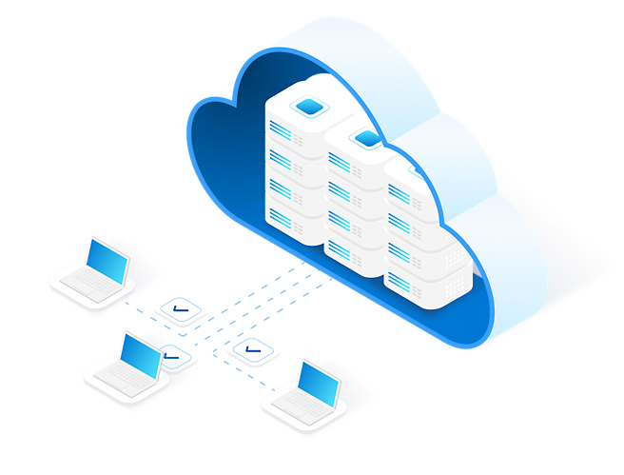








</> APIs
Adaptive Access

